Slide 1
Heretto Quickstart How do I create, assemble, and build my first DITA publication in Heretto CCMS?

Slide 2
Guidepost
Purpose
This resource provides step-by-step procedures for how to author and publish XML DITA content in the Heretto CCMS.
Create DITA topics and maps.
Organize publications by linking topics to a map.
Add XML content to generic, concept, task, and reference topics.
Generate PDF output from a map.
Learning objective(s)

Slide 3
Use case (scenario)
Let’s pretend that you are a member of a research team exploring generative AI applications. Your colleagues have researched ChatGPT and WOMBO Dream, but need someone (you) to provide an introduction to Google Gemini.
You don’t know whether your research team would be delivering PDF, web pages, or both. To play it safe, you want to separate your content from its presentation.
Your introduction should include a working definition of generative AI (concept), a procedure about using Google Gemini (task), and a set of sample questions to test Google Gemini (reference).
Each one of those entries will be a separate DITA topic referenced from a DITA map. You can then process that one DITA map to produce multiple output formats.

Slide 4
Task overview
Log in to a Heretto CCMS cloud account.
Create a folder in Heretto for your DITA files.
Create a DITA map.
Create some DITA topics (general, concept, task, reference).
Populate the topics with content.
Create references from your DITA map to those topic(s).
Publish your content using built-in processors as PDF, HTML, and web help.

Slide 5
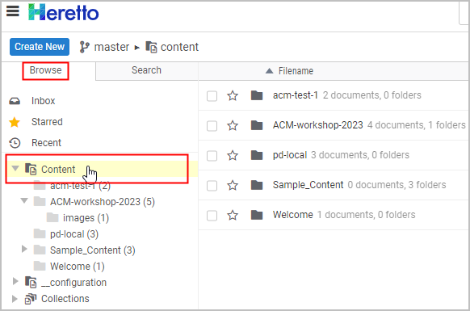
Create a folder in Heretto for your content
In a web browser, open and log in to Heretto CCMS.
In the Browse tab, click the Content heading to display current folders.
Note: The folders that you see in your repository will vary from this example.

Slide 6
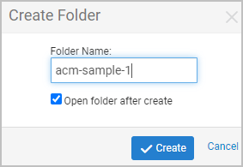
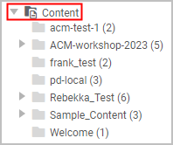
Create a folder in Heretto for your content
On the right-hand side of the toolbar, click the Create a new folder icon.
In the Create Folder dialog box, provide a name for your new folder and click Create.
Refresh (expand and collapse) the Content branch.

Slide 7
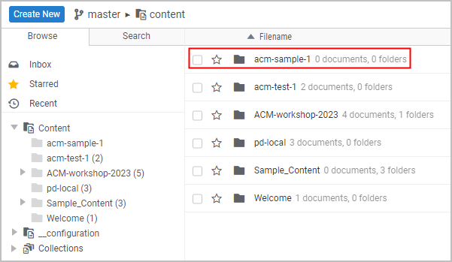
Create a folder in Heretto for your content
Heretto creates the folder and displays it in Content.

Slide 8
Create a DITA map
Double-click the folder into which you want to add your map, for example acm-sample-1.
Click the Create New button to display a list of available DITA map and topic types.

Slide 9
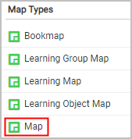
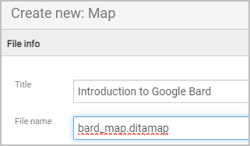
Create a DITA map
Under the Map Types section, click the Map item to open the Create New: Map dialog box.
In the Create New: Map dialog, provide a title for your map and a file name.

Slide 10
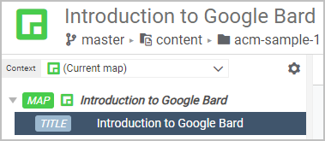
Create a DITA map
Click Create & Edit to create the map. Heretto displays the new map in the Map Editor.

Slide 11
Create a DITA map
Click the Open Library button at the bottom of the screen to display a list of available folders next to the Map Editor folders.
Heretto lists the new DITA map (bard_map.ditamap) in the folder named acm-sample-1. We'll come back to this map after we have created some topics.

Slide 12
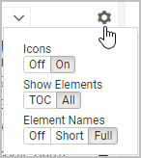
Create a DITA map
Heretto allows you to customize how much information it displays as you edit maps and topics. For example, in the DITA Map Editor, you can click the Settings icon to display a list of display options.

Slide 13
Create a DITA map
What have we accomplished?
DITA is modular. Unlike Google Docs or MS Word, you author content in small modules (topics) which you then assemble into various publications using maps.
Maps are the blank canvas upon which you organize your publication. They provide the higher brain functions.

Slide 14
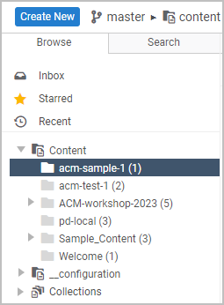
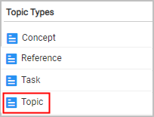
Create a DITA topic (generic topic)
Select the folder into which you want to create the new topic.
Click the Create New button to display a list of available DITA map and topic types.
In the list of Topic Types click Topic.

Slide 15
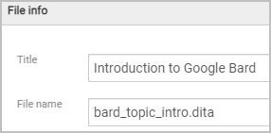
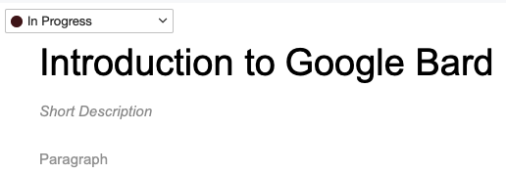
Create a DITA topic (generic topic)
In the Create New: Topic dialog box, provide a topic title and a file name.
Click the Create & Edit button to create the topic and to open it in the Topic Editor.

Slide 16
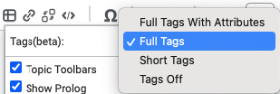
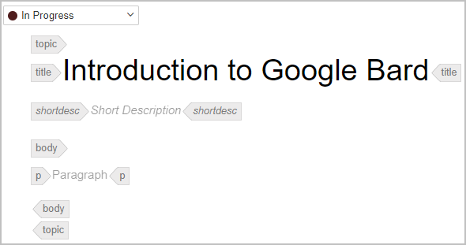
Create a DITA topic (generic topic)
Click the Options icon ( ) and choose Full Tags to display DITA elements in the Topic Editor. While you are learning DITA, it is useful to display the XML element names.

Slide 17
Create a DITA topic (generic topic)
Click the Open document in a new tab icon. Displaying topics in separate tabs is not required, but convenient.
Click inside the set of tags delimiting any element. Heretto displays a plus sign (+) beside the selected element.

Slide 18
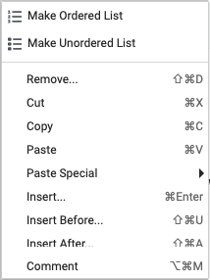
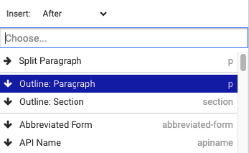
Create a DITA topic (generic topic)
Right-click to display a list of options.
Click Insert Before or Insert After to specify the location of the new element.
From the list of available elements, click the one you want to insert, for example a <p> (paragraph).

Slide 19
Create a DITA topic (generic topic)
Heretto inserts the element and places the cursor where you can enter content.

Slide 20
Create a DITA topic (generic topic)
What have we accomplished?
The DITA generic topic is the most flexible topic type because it makes no assumption about what sort of content it contains. The generic topic is actually useful as a root (top-most) topic in your map or map branch. You can then nest more specific topic types such as "concept" or "task" beneath these root topics.
In linear writing, we might call generic topics "transition sections" or "orientation topics".

Slide 21
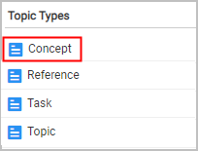
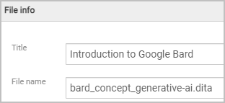
Create a DITA topic (concept topic)
Select the folder into which you want to create the concept topic. Note: At any time you can click your browser refresh button to restore your initial (Browse) view.
Click the Create New button to display a list of available DITA topic types.
In the list of Topic Types, click Concept.
In the Create New: Concept dialog box, provide a topic title and a file name.

Slide 22
Create a DITA topic (concept topic)
Click the Create & Edit button to create the topic and to open it in the Topic Editor.
Click the Open document in a new tab icon.
Click inside the <shortdesc> element and enter text that summarizes the topic.

Slide 23
Create a DITA topic (concept topic)
Click inside the <conbody> and insert a paragraph <p> for content that begins topic content. DITA concept topics answer the question, "What is this thing?" Our topic answers the question, "What is generative AI?" It is useful to place concept topics toward the top of your map or map branch to help orient the reader.

Slide 24
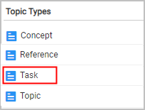
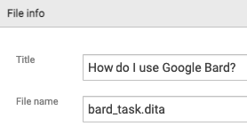
Create a DITA topic (task topic)
Select the folder into which you want to create the task topic. Note: At any time you can click your browser refresh button to restore your initial (Browse) view.
Click the Create New button to display a list of available DITA topic types.
In the list of Topic Types, click Task.
In the Create New: Task dialog box, provide a topic title and a file name.

Slide 25
Create a DITA topic (task topic)
Click the Create & Edit button to create the topic and to open it in the Topic Editor.
Click the Open document in a new tab icon.
Click inside the <shortdesc> element and enter text that summarizes the topic.
Click inside the <taskbody> <context> element and describe the context for the task.

Slide 26
Create a DITA topic (task topic)
In the <steps> element, specify the following <step> elements for the procedure. DITA task topics answer the question, "How do I use this thing?"

Slide 27
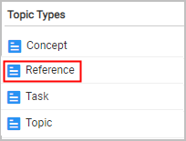
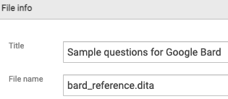
Create a DITA topic (reference topic)
Select the folder into which you want to create the reference topic. Note: At any time you can click your browser refresh button to restore your initial (Browse) view.
Click the Create New button to display a list of available DITA topic types.
In the list of Topic Types, click Reference.
In the Create New: Reference dialog box, provide a topic title and a file name.

Slide 28
Create a DITA topic (reference topic)
Click the Create & Edit button to create the topic and to open it in the Topic Editor.
Click the Open document in a new tab icon.
Click inside the <shortdesc> element and enter text that summarizes the topic.

Slide 29
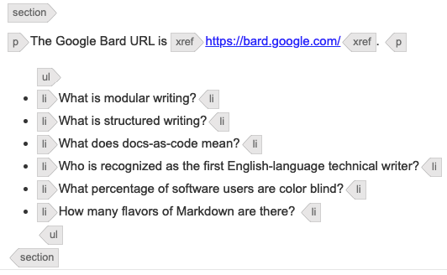
Create a DITA topic (reference topic)
Right-click inside the <refbody> element and insert a <section> element.
Within the <section> element, create and populate an introductory paragraph <p>.
Append an unordered list (<ul>) element and multiple list items (<li>). DITA reference topics answer the question, "What other information is relevant to or part of my subject?" Examples are common.

Slide 30
Create a DITA topic (reference topic)
What have we learned?
DITA topics are the building blocks of DITA publications.
All DITA topics have some common elements such as <title> and <shortdesc>.
Most DITA topics are "typed". The elements that are valid for one topic type may be different from the elements valid for another topic type. Topic typing encourages writers to focus on the specific type of information that they are developing.

Slide 31
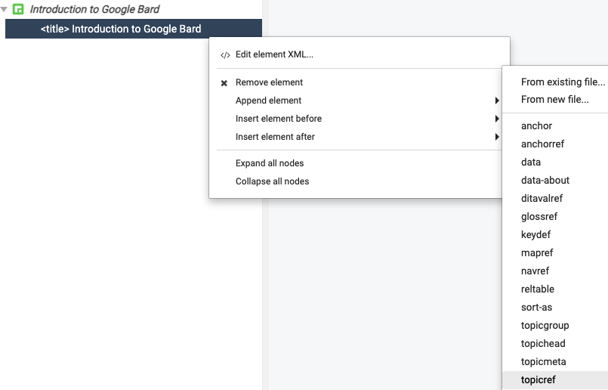
Reference your DITA topics from your map
Double-click the DITA map that you created previously to open it in the Maps Editor.
In the Maps Editor, right-click the <title> element to specify it as the location of a new element and its name.
Click "topicref" in the list of valid elements.

Slide 32
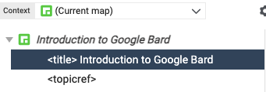
Reference your DITA topics from your map
In this example, Heretto inserts a <topicref> element.
Select the map <topicref> element and click the Edit element properties icon.
In the Properties dialog box, click the Change button under the @href attribute to select the topic you want to reference from your map.

Slide 33
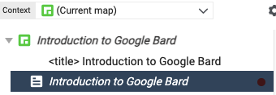
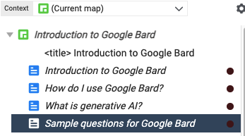
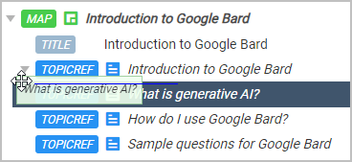
Reference your DITA topics from your map
Heretto inserts a <topicref> element that references the topic file bard_topic_intro.dita.
Add references to the other topics that you have created.
Select a topic reference in the map and drag it to the appropriate position and indentation level.

Slide 34
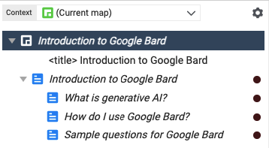
Reference your DITA topics from your map
Heretto indents the <topicref> elements. You now have all the maps and topics that you need to publish your content.

Slide 35
Reference your DITA topics from your map
What have we learned?
In modular environments such as DITA, the modules you author (topics) and the assemblies within which you organize your modules (maps) are distinct.
Topics inherit their level and formatting from the map that references them. If you referenced the same topic in three different maps, it could appear as an H1, H2, or H3 in the three sets of generated output.
Topics provide content. Maps provide hierarchy.

Slide 36
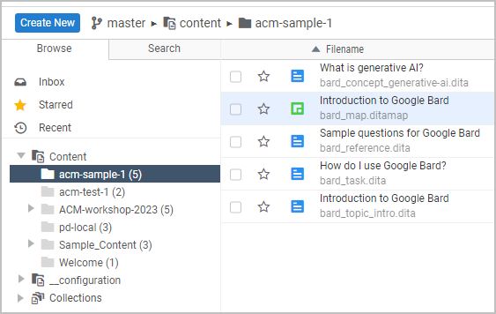
Build your DITA content
Under the Browse tab, select the folder that contains the map that you want to publish.
For an overview of publishing options in Heretto, see Heretto Publishing.

Slide 37
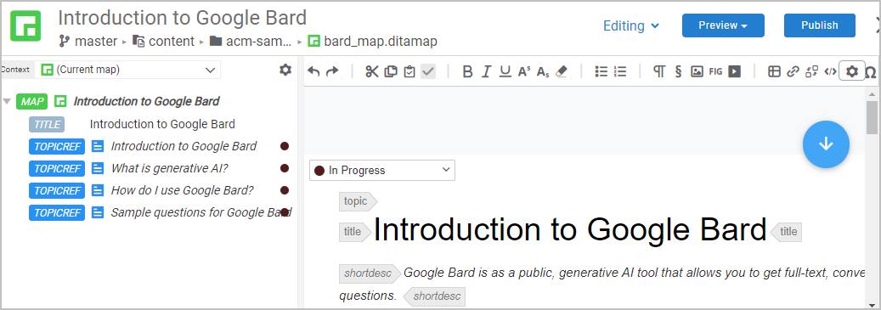
Build your DITA content
Double-click the DITA map to open the map and the topics that it references in the editor.

Slide 38
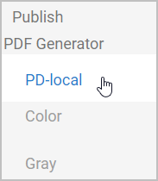
Build your DITA content
Click the Publish button to specify that you want to publish the current map.
In the Publish dialog box, click the publication scenario (output format) that you want.

Slide 39
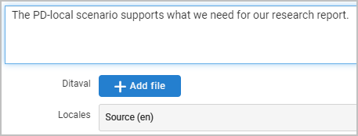
Build your DITA content
Provide some metadata (a description) about this publication.

Slide 40
Build your DITA content
Click the Publish button to submit your DITA sources to the PDF processor. Heretto processes your content and provides a link to the generated output (a PDF file in this case).
Click the link in the Description column to open an inventory of your publications.

Slide 41
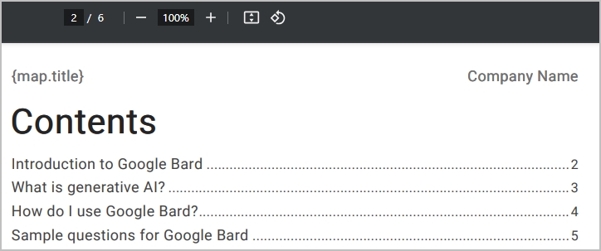
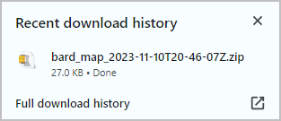
Build your DITA content
Click the link under Key Assets to view the generated output.
Click the Download button to save the generated PDF to your Downloads folder.

Slide 42
Build your DITA content
What have we learned?
DITA separates source XML content from generated PDF or HTML presentation.
DITA processors read one DITA map and generate a specific set of PDF, HTML5, or WebHelp deliverables. This is genuine single sourcing.
If you have experience programming in XML, you can customize the out-of-the-box Heretto DITA processors to make your output reflect a particular presentation style.

Slide 43
Thank You!
See the Committee on Structured Authoring and Content Management page of the ACM SIGDOC website to learn more about committee activities, available resources, and volunteer opportunities.
See https://acm-sigdoc-structured.org to learn more about committee activities, available resources, and volunteer opportunities.

